Slide 1
Data Science with Python
STEM INSTITUTE 2019
Dr. Parisi and Dr. Scharff
Pace University

Slide 2
Learning Outcomes
After completing this program you will:
Be more knowledgeable about what Data Science is
Be introduced to basic statistics
Be familiar with the Python language fundamentals
Be familiar with the most common Python data structures and libraries for Data Science
Be able to create visualizations with Python
Be able to use Python to carry out basic statistical modeling and analysis
Be familiar with Design Thinking
Have developed teamwork and communication skills
Have applied knowledge on a project based on real data

Slide 3
Data Science with Python
Session I
STEM INSTITUTE 2019

Slide 4
Overview of the Program
Academic content

Slide 5
What will you learn?
Python
Data Science
Design Thinking
Statistics
Software Enginee-ring
Project
Billion Oyster Project Data

Slide 6
Your Programming Experience
You?

Slide 7
What is programming?
Toward a definition

Slide 8
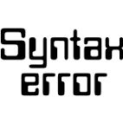
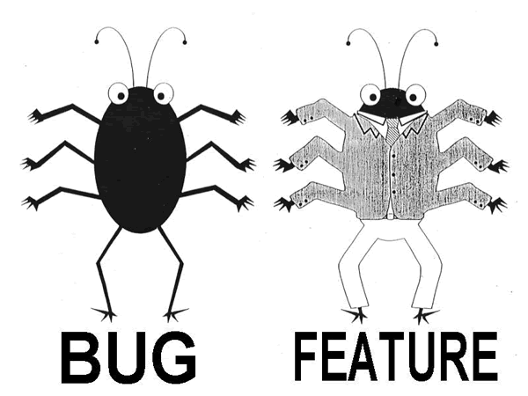
What is a programming?
Programming is about “instructing a computer to perform specific tasks”. These tasks can form an algorithm
A programming language provides “a vocabulary and set of grammatical rules” for programming
SYNTAX
SEMANTICS
Source: http://www.webopedia.com

Slide 9
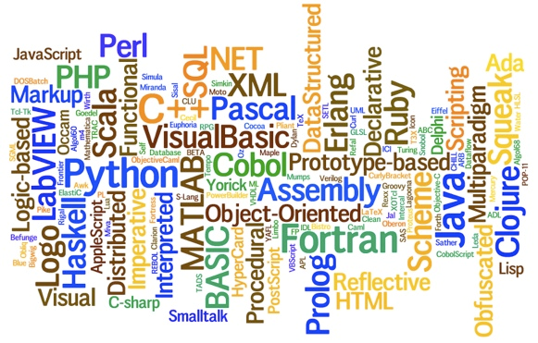
Programming Languages

Slide 10
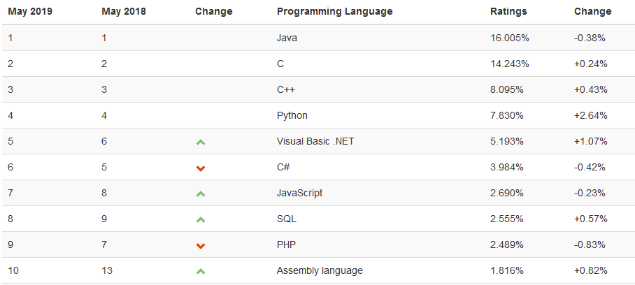
TIOBE Index for May 2019

Slide 11
Python
Introduction

Slide 12
Outline
What is Python?
Comments
Calculating with Python
Variables
print() function
Types - int, float, boolean, string

Slide 13

Source: https://xkcd.com/353/

Slide 14


What is Python?
Python was designed by Guido van Rossum and first released in 1991
It is named after the British comedy troupe Monty Python's Flying Circus
It is an interpreted language
Its design is distinguished by its emphasis on readability, simplicity and explicitness
Libraries enhance the capabilities of Python. They are here to help you, developers and make it faster to program!
We will cover: NumPy, pandas, matplotlib, IPython, SciPy, Jupyter, scikit-learn
Notes:
Less verbose

Slide 15
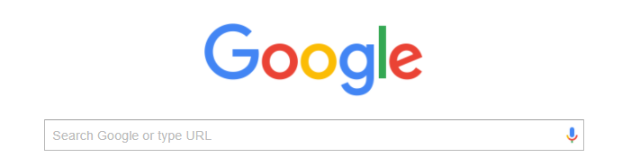
Getting Help
Python official documentation
https://docs.python.org/3/
StackOverflow
https://stackoverflow.com

Slide 16
Toolbox
Python
https://www.python.org/downloads
Anaconda (or Miniconda)
https://www.anaconda.com/distribution/#download-section
SublimeText
https://www.sublimetext.com
Packages for Data Science
numpy, pandas, scikit-learn, matplotlib, seaborn
Other packages: statistics, statsmodel, scipy, jupyter, notebook

Slide 17
Let’s start coding...

Slide 18
Command line first...

Slide 19

Use of the Sublime Text editor
Execute code with: python file.py on the command line

Slide 20

Use of the Jupyter Notebook
Execute jupyter notebook on the command line
Notes:
Show the tab

Slide 21
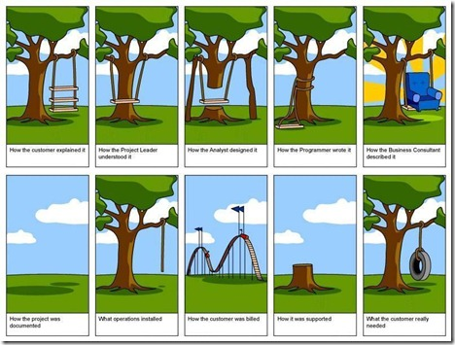
Comments
Comments are introduced by # in Python
Multiple line comments are between triple-quote strings '''
Comments are important for code evolution and maintenance

Slide 22
Calculating with Python
10 * 50
10 * 5 + 3 - 1
(10 * 5) + 3 - 1
10 / 3
10 // 3 # truncating division
10 % 3 # remainder
2 ** 10 # power

Slide 23
Variables
x = 5 # assignment
x + 6
y = 10
x + y
a, b = 3, 5
a, b = b, a+1

Slide 24
Print Function
print(“Hello World”)
print is a function
“Hello World” is the argument. It is a string
We use parentheses when calling a function on specific arguments
x = 3
print(x)
Prints the value of the variable x

Slide 25
Typing
In Python, everything is an object
Python infers types (dynamic typing)
The function type(...) can be used to determine the type of an expression
type(3) # int
type(“Hello”) # str
type(3.4) # float

Slide 26
Boolean
b1 = True
b2 = False
# boolean operators
not b1
b1 or b2
b1 and b2
# boolean expressions
a, b = 3, 5
a == b
a != b
a < b
a <= b
Notes:
Should have one thing on float

Slide 27
String
Immutable sequence of characters. Identified by single or double quotes
s = “This is a string ”
s * 3 # repeats the string 3 times
s + “ Another string” # concatenation of strings
s[0] # string begins at index 0
s[1:3] # substring from position 1 to 3-1=2
s[2:] #substring from position 2
s[-1] # index from the right side
s1 = ‘A quote “ ‘ # use of quote in a string. You can also use 3 single quotes
text = “This is a string %s” # to create parameterized strings
print(text % 5) # returns This is a string 5
len(s1) # length of s1
Notes:
https://docs.python.org/3.6/library/string.html?highlight=string#module-string

Slide 28
String
s = “This is a string ”
“T” in s # check if T is in the string
s.replace(“t”,”o”) # replace method applied on object s
How to get ‘ll’ from a string containing ‘Hello’?
Notes:
https://docs.python.org/3.6/library/string.html?highlight=string#module-string

Slide 29
String
Methods
https://docs.python.org/3/library/text.html
str.capitalize() - Return a copy of the string with its first character capitalized and the rest lowercased.
str.split([sep[, maxsplit]]) - Return a list of the words in the string, using sep as the delimiter string. If maxsplit is given, at most maxsplit splits are done (thus, the list will have at most maxsplit+1 elements). If maxsplit is not specified or -1, then there is no limit on the number of splits (all possible splits are made).
str.upper() - Return a copy of the string with all the cased characters converted to uppercase.
new_string = "How, are, you"
new_string.split(",") # ['How', ' are', ' you']

Slide 30
Homework
Python
We consider a string s and want to get a new string built from s, with lower cases only and no spaces
Data
Read chapter 1 from “Introductory Statistics” available at https://openstax.org/details/books/introductory-statistics
Solve HW problems #80, 85, 86, 88

Slide 31
Join Slack
Slides
https://stem2019workspace.slack.com
Join from here: http://bit.ly/stem2019slack
http://bit.ly/stem2019slides

Slide 32
Data Science
Overview

Slide 33
Outline
What are data?
Terminology
Data Science concept and process
Data Science in action exercise

Slide 34
What do you know about data and data science?
Exercise

Slide 35
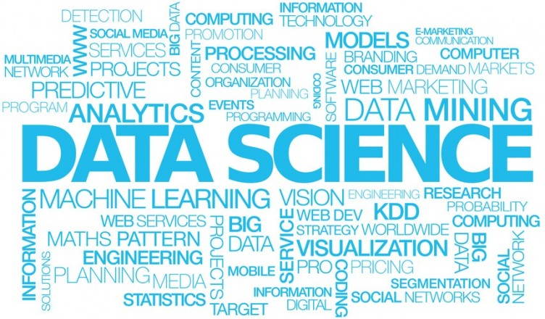
Source: http://www.abcrnews.com/demand-for-certified-data-scientists-is-far-greater-than-the-supply

Slide 36

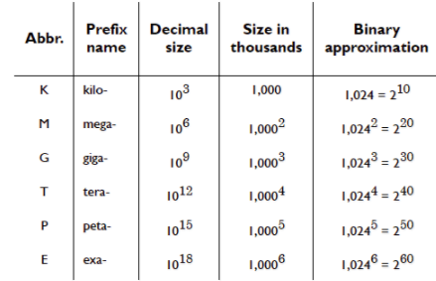
What are data?
Data are everywhere
Text, Excel file, web data, videos, pictures, social networking data etc.

Slide 37
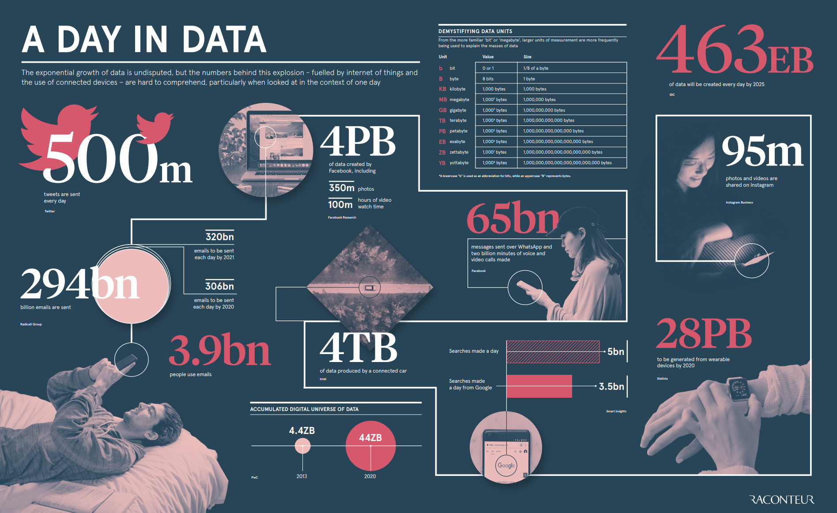
How much data is produced every day?
Source: https://www.visualcapitalist.com/wp-content/uploads/2019/04/data-generated-each-day-wide.html

Slide 38
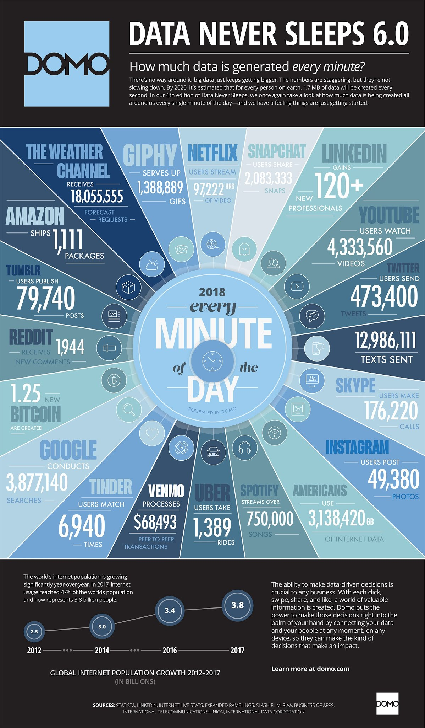
What happens in a minute?
Source: https://www.socialmediatoday.com/news/how-much-data-is-generated-every-minute-infographic-1/525692/

Slide 39
Terminology
Big Data - large data sets analyzed for finding patterns and associations
Data Analytics - quantitative and qualitative methods to analyze data and extract information
Data Mining - examining large databases in order to generate new information. Techniques include: classification, decision tree, prediction etc.
Data Science - multidisciplinary approach to decision making and model development
Machine Learning - machine learning explores the study and construction of algorithms that can learn from and make predictions on data
Deep Learning - using neural network technology with multiple hidden layers for machine learning
Neural network: a computing system made up of a number of simple, highly interconnected processing elements.
A neural network might have hundreds or thousands of processor units, whereas the brain has billions of neurons

Slide 40
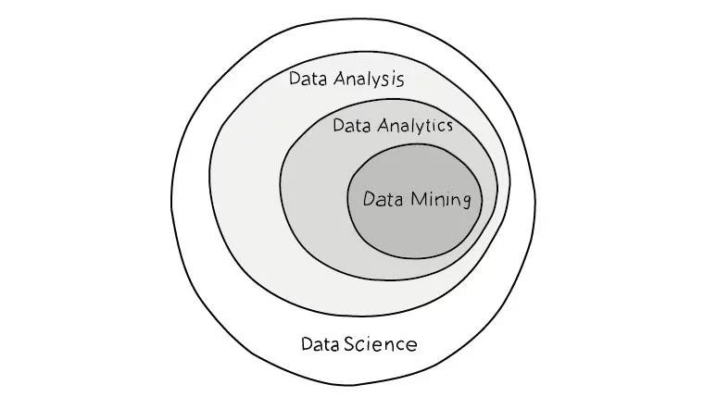

Slide 41
Quiz
Computing the number of packages sent by amazon in the first quarter of 2017
Amazon.com recommends to “Mr. Robot” fans to watch “Silicon Valley”
70% of Macy’s sales are done online.
Data Science? Data Mining ? Big Data? Other?
Notes:
What does it corresponds to?

Slide 42
Data Scientist: The Sexiest Job of the 21st Century
Harvard Business Review October 2012
“It’s a high-ranking professional with the training and curiosity to make discoveries in the world of big data.”
https://hbr.org/2012/10/data-scientist-the-sexiest-job-of-the-21st-century

Slide 43
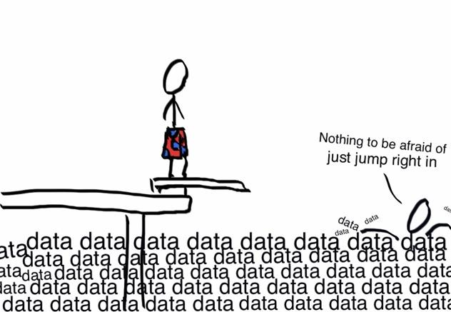
Source: http://www.business2community.com/b2b-marketing/data-key-b2b-marketing-lead-generation-01286713#LQ5MR55j7osPizHU.97
Notes:
what data scientists do is make discoveries while swimming in data
What is the job of the data scientist
You could talk about your experience

Slide 44
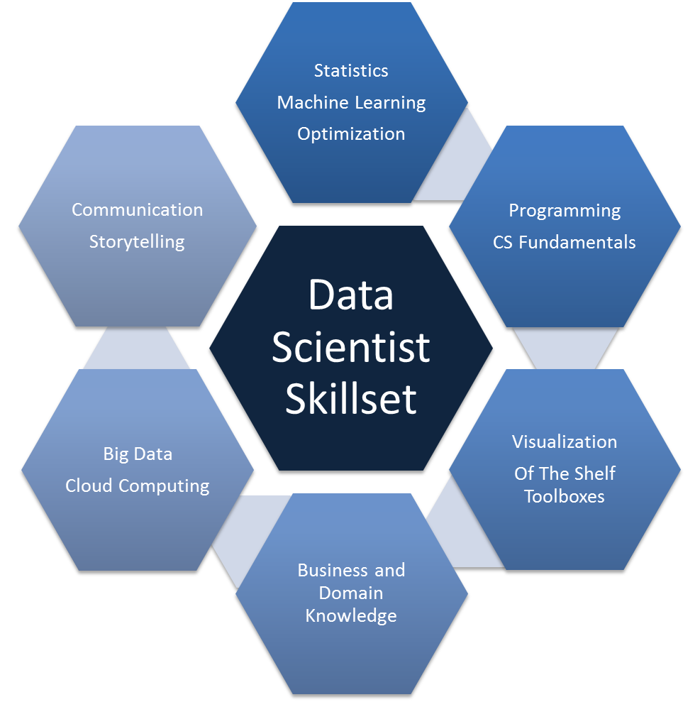
https://datasciencedojo.com/what-are-the-key-skills-of-a-data-scientist/

Slide 45
End of the 1st session

Slide 46
Data Science with Python
Session II
STEM INSTITUTE 2019

Slide 47

Data Science Concepts and Process
Data Science relies significantly on statistical analysis, BUT is much more than statistical analysis
Emphasis on project definition and collaboration
Project roles
Project sponsor
Client or Subject Matter Expert (SME)
Data scientist
Data architect
Operations
...

Slide 48
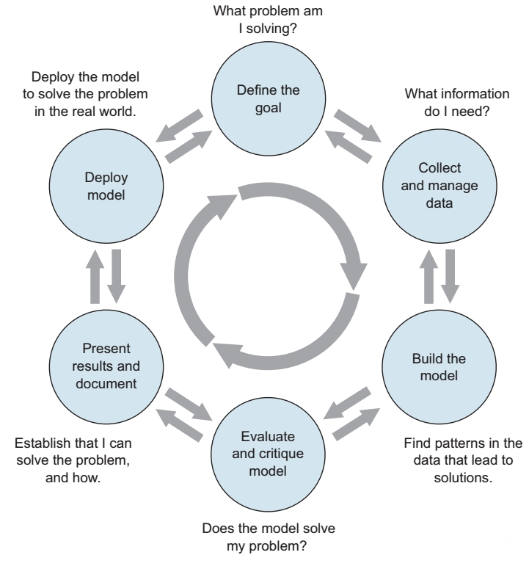
Data Science Concepts and Process
Data Science Project Lifecycle
Project goal -- why are we doing this?
Data collection, quality, sufficiency, and management
Exploratory analysis and model development
Model evaluation and sufficiency
Presentation to stakeholders, project documentation, and reproducibility

Slide 49
Data Science Concepts and Process
Data Science Project Lifecycle
Project goal -> Question, hypothesis
Data collection, quality, sufficiency, and management -> Survey, files
Exploratory analysis and model development -> Summary statistics, plots, models
Model evaluation and sufficiency -> Tests on ‘new’ data, measures of accuracy
Presentation to stakeholders, project documentation, and reproducibility -> PowerPoint, report, article

Slide 50
Data Science Concepts and Process
Communicating Results
You’re telling a story
What are the questions you’re seeking to answer?
Why are these interesting questions?
Use graphs and diagrams to clarify, not confuse or mislead

Slide 51

Data Science Concepts and Process
Communicating Results
What’s wrong with this graphic?
There are several Issues
Can you identify them?

Slide 52
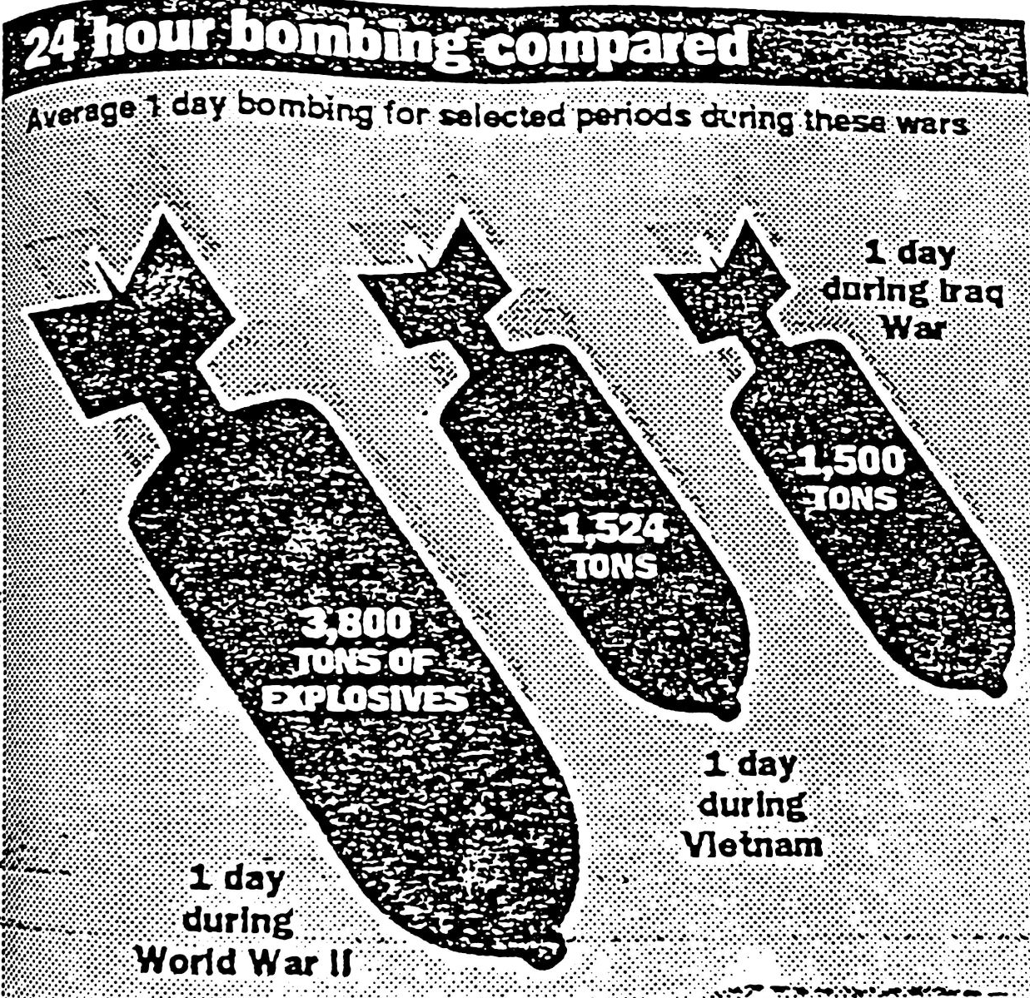
Data Science Concepts and Process
Communicating Results
Better…..

Slide 53

Data Science Concepts and Process
Communicating Results
Napoleon's Russian campaign of 1812 is shown in this classic picture, by Charles Joseph Minard (1781-1870).

Slide 54
Data Science Concepts and Process
Scientific Methodology
Formulate the question you want to answer
Review the published research and understand what has been done to-date and how your work fits in
State your hypothesis
Design the experiment
Collect data, clean data
Analyze the data and draw conclusions
Document/publish your findings

Slide 55
Data Science Concepts and Process
Key Concepts
A successful data science project involves more than just statistics
It also requires a variety of roles to represent business and client interests, as well as operational concerns
Make sure you have a clear, verifiable, quantifiable goal
Make sure you’ve set realistic expectations for all stakeholders

Slide 56
Data Science in Action
Text analysis of “The Murders in the Rue Morgue” - Edgar Allan Poe
Each team selects one page from the story
Draw three random samples of text from the page, containing five lines
Count the occurrence of each vowel in each sample
Display your results for each of the three samples
Estimate the mean for the most frequently occurring vowel
Present your results
What is the frequency of each vowel in five lines from the story?
What is the mean frequency for the vowel occurring most often?
Notes:
https://en.wikipedia.org/wiki/Georges_Perec wrote without E

Slide 57
Data Science
Billion Oyster Project Data Exploration

Slide 58
A First Look at BOP Data
Data
Access the data https://platform.bop.nyc/expeditions/data
Data how to guide https://github.com/BillionOysterProject/docs/wiki/Data-How-To-Guide
Digital Platform User Guide Table of Contents https://github.com/BillionOysterProject/docs/wiki/Digital-Platform-User-Guide-Table-of-Contents
Sample data http://bit.ly/STEM-2019-Sample_Data
Resources
Field Science Manual: Oyster Restoration Station https://drive.google.com/file/d/0Bzf_STNcTtRmZF9ldmdWRzcxdFk/view
Sample research questions
Middle school students’ research projects https://www.flickr.com/photos/nyhf/sets/72157683204769971/page1

Slide 59
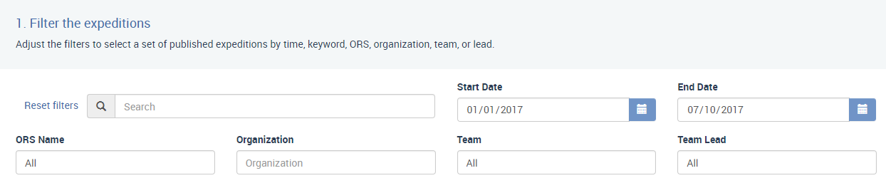
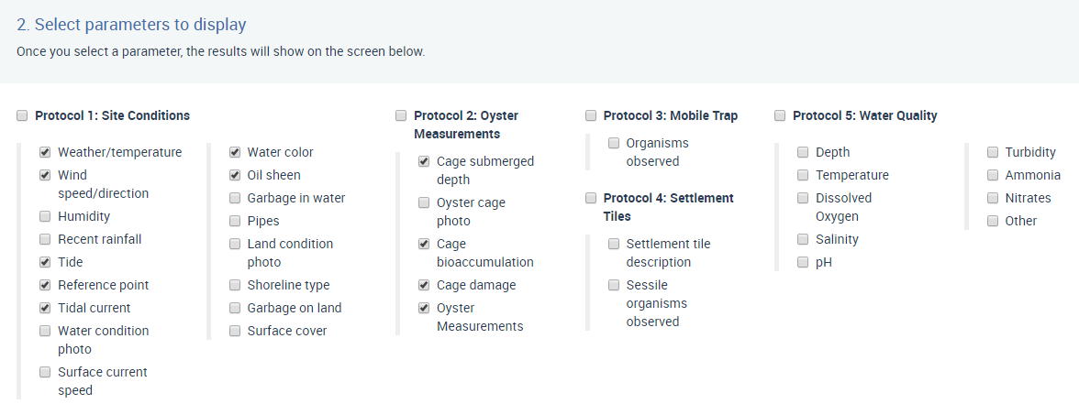
Go to https://platform.bop.nyc/expeditions/data
Download data
Tell us what you downloaded
Choose your own parameters!

Slide 60
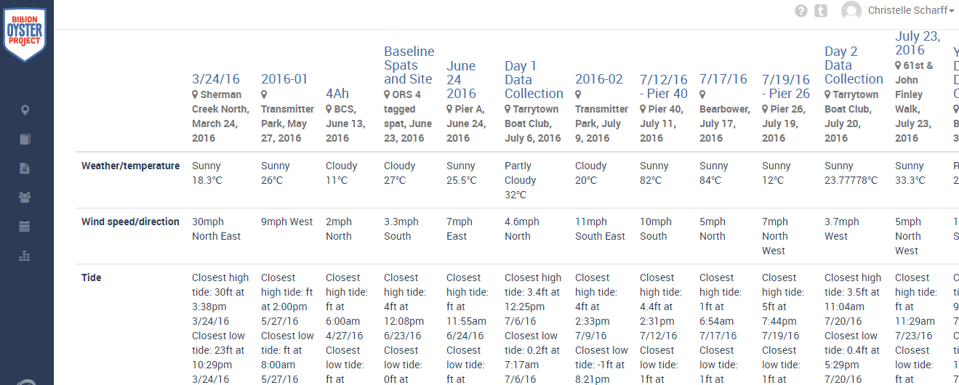
Overview of the data

Slide 61
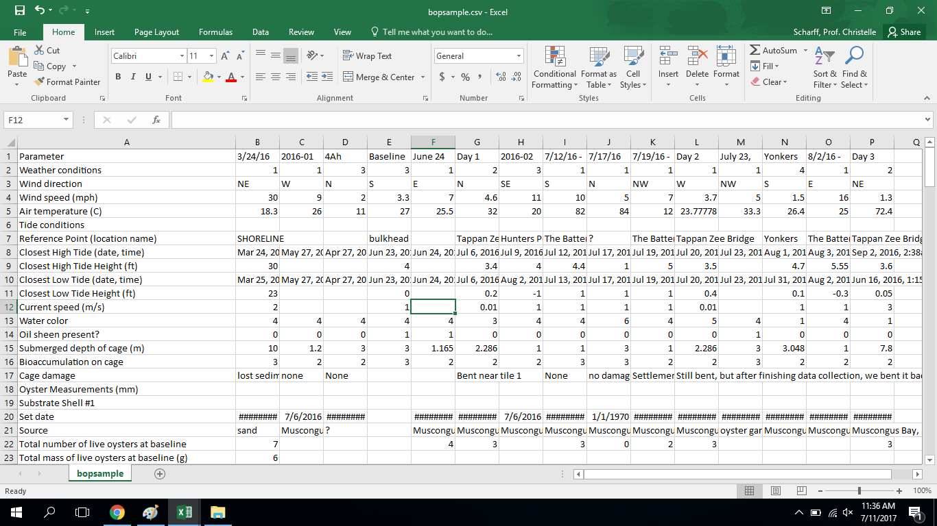
CSV file

Slide 62
High level exploration of the data
Explore the CSV file
What is your first impression?
How do you read these data?
What are the rows?
What are the columns?
Where do you see the parameters you chose?

Slide 63
What problems you expect with the data?
What is confusing about these data?
What problems do you see with these data?
Missing data? Errors? Out of range? Etc.

Slide 64
Meaning of the data
What do the data describe?
How would you query the data?
What questions can you answer from these data?
What questions can’t you answer from these data?

Slide 65
Processing the data with Python
How would you process these data with Python?
Importing the file, content of the cell as strings, missing data, using part of the data etc.
How will you do this in Python?

Slide 66
Sample questions
Is the size of oyster normally distributed?
Is there a correlation between quality of water and the size of the oysters?
What else?

Slide 67
Homework
Python
We consider a string s and want to get a new string built from s, with lower cases only and no spaces
Data
Read chapter 2 from “Introductory Statistics” available at https://openstax.org/details/books/introductory-statistics Solve HW problems #74, 79, 80, 90, 100
Explore the BOP data and get more comfortable with them

Slide 68
End of the 2nd session

Slide 69
Data Science with Python
Session III
STEM INSTITUTE 2019

Slide 70
More Python

Slide 71
Outline
More types - List, Tuple, Dictionary
More calculations with Python
Defining functions
If statements
Loops

Slide 72
List
Mutable collection of elements. Identified by brackets. Can have duplicates
fruit_list = [ “apple”, “orange”, “lemon”]
fruit_list.append(“grape”)
print(fruit_list)
fruit_list[2] # starts at position 0
fruit_list[-2]
fruit_list[10]
fruit_list[1:2] # list[start:end] provides the items from start through end-1
fruit_list[2:]
del fruit_list[1]
list1 = [1,2,3]
list2 = [4,5]
list3 = list1 + list2 # concatenation
list1 * 2
my_list = [“apple”, 1] # list of elements of different types
number_list1 = list(range(1,10)) # list is a constructor
number_list2 = list(range(3))

Slide 73
List
Methods
https://docs.python.org/3/tutorial/datastructures.html
list.append(x) - Add an item to the end of the list. Equivalent to a[len(a):] = [x]
list.insert(i, x) - Insert an item at a given position. The first argument is the index of the element before which to insert, so a.insert(0, x) inserts at the front of the list, and a.insert(len(a), x) is equivalent to a.append(x).
list.remove(x) - Remove the first item from the list whose value is x. It is an error if there is no such item.
list.count(x) - Return the number of times x appears in the list.
list.sort(key=None, reverse=False) - Sort the items of the list in place
list.reverse() - Reverse the elements of the list in place.
list.copy() - Return a shallow copy of the list. Equivalent to a[:].

Slide 74
Create a list of 8 sports from an empty list using the append operation only
Construct a list composed of the elements from position 2 to 5 using slicing
Create a list of lists of ints

Slide 75
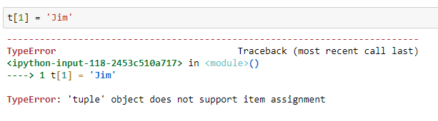
Tuple
Immutable sequence of elements. Identified by parentheses
t = (5, “John”)
t[1]

Slide 76
Dictionary
Mutable sequence of elements where each element can be accessed via a key and has a value. Identified by curly braces
sport = {"John" : "Soccer", "Jim" : "Baseball", "Paul" : "Football"}
sport[“John”]
sport[“John”] = “Tennis”
del sport[“Paul”]

Slide 77
Quiz
List of grocery items to buy
Pair of elements
To-do list
Words and their definitions
Number of each word in a text
List, Tuple, Dictionary ?

Slide 78
More Calculations with Python
import math
math.pi
math.cos(0)
math.floor(3.4)
math.ceil(3.4)
https://docs.python.org/3.6/library/math.html

Slide 79
Defining a Function
To organize and reuse code
Functions are introduced with the def keyword
A function that returns a result uses return
Indentation is used to delimit blocks - 4 spaces or tab
def simpleFunction():
print("I made a function")
def square(x):
return x * x
def square(x):
y = x * x
return y

Slide 80
Define a function that returns the power of 2

Slide 81
If Statements
if, elif and else are used to write conditionals
Indentation is used to delimit blocks - 4 spaces or tab
if x < 0:
print ("Negative number")
if x < 0:
print ("<0")
else:
print (">= 0”)
if x == 0:
print("Zero number")
elif x < 0:
print ("Negative number")
else:
print ("Positive number")

Slide 82
Define a function that returns the max of 2 ints

Slide 83
Homework
Python
Define a function that returns the maximum of 3 numbers and pretty print the answer
Data
Explore the BOP data and get more comfortable with them
If you have not yet done so, read chapters 1 and 2 of https://openstax.org/details/books/introductory-statistics Solve problems CH 1 #80, 85, 86, 88; CH 2 #74, 79, 80, 90, 100

Slide 84
End of the 3rd session

Slide 85
Data Science with Python
Session IV
STEM INSTITUTE 2019

Slide 86
More Python

Slide 87
Solution of the homework
def max3(x, y, z):
max = x
if y > max:
max = y
if z > max:
max = z
if y > z:
max = y
print("The max of " + str(x) + ", " + str(y) + ", " + str(z) + " is " + str(max))
return max

Slide 88
Define a function that compares the lengths of 2 strings and returns the longest string
NB: If the strings have the same length, return the concatenation of the 2 strings

Slide 89
Loops
Loops are used to repeat pieces of code
for x in range(0,5):
print(“Hello World”)
# print the elements of a list
my_list = [10,2,3]
for elt in my_list:
print(elt)

Slide 90
Pair programming exercise - one person dictates the code, one person write the code
Write a loop that pretty-print the elements of list
Write a loop that sum the elements of a list of int

Slide 91
Statistics

Slide 92
Outline
Fundamentals of statistics
Variables
Measure of central tendency
Five number summary
Skewness
Measure of spread

Slide 93
Fundamentals of Statistics
Statistics is the science of collecting, organizing, summarizing, and analyzing data
Moreover, statistics is about providing a measure of confidence in any decision or conclusion
In statistical analysis we work with a sample and make inferences about the population
What is the difference between a sample and the population?
The entire group of individuals being studied is the population
An individual is a member of the population
A sample is a subset of the population

Slide 94
Variables
Characteristics of the data we are studying are called variables
Variables that can be neatly placed into well-defined groups, or categories, that do not depend on order, are categorical or qualitative variables
Variables that are numerical are quantitative variables
Variables can be further divided into four levels of measurement
Nominal - values of the variable are names: ‘blue’, ‘red’, ‘green’
Ordinal - order is significant but the distance between values doesn’t have meaning: ‘first’, ‘second’, ‘third’
Interval - distance between values has meaning: ‘40⁰ C’ & ‘41⁰ C’ the same as ‘0⁰ C’ & ‘1⁰ C’
Ratio - ratio of continuous quantity and has an absolute zero: 100 is twice as large as 50

Slide 95
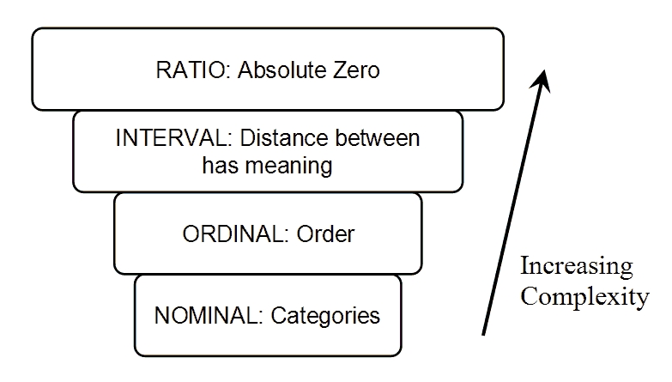
Variables
Levels of Measurement

Slide 96
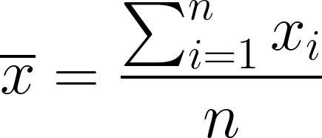
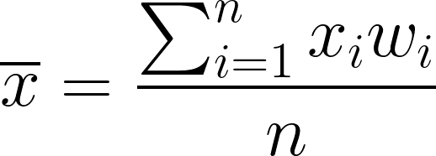
Measures of Central Tendency - Mean and Weighted Mean
Sample mean
Weighted mean
The weights add up to 1
Notes:
Big sigma = sum
Example of grades

Slide 97
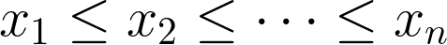
Measures of Central Tendency - Median and Mode
Median
First sort the data
If n is odd, the median is the middle value
If n is even, the median is the average of the two middle values
Mode is the most frequently occurring value

Slide 98
Measures of Central Tendency with Python
""" Working with numpy and scipy -- basic stats First create an array -- one dimensional ==> vector """ # import the modules we need # using 'as' allows us to use an alias import numpy as np import scipy as sp import matplotlib.pyplot as plt import pandas as pd import statistics as stats

Slide 99
Measures of Central Tendency with Python
x = np.array([1, 2, 3, 7, 4, 5, 4, 6, 8, 10, 2.8, 4, 4, 3, 4, 5])
x is an instance of an ndarray. The type of x is ndarray
""" Calculate the mean either use the mean() method with instance x or call it using np explicitly and passing x as a parameter or use the built-in mean from the statistics module """ x.mean() np.mean(x) stats.mean(x)
1 | 2 | 3 | 7 | 4 | 5 | 4 | 6 | 8 | 10 | 2.8 | 4 | 4 | 3 | 4 | 5

Slide 100
Measures of Central Tendency with Python
# weighted mean
np.average(x, weights=[0.0625, .0625,0.1,0.0025,0.0625,0.1225,0.025, 0.0625,0.0625,0.0625,0.0625,0.0625,0.0625,0.0625,0.0625,0.0625])
np.median(x) stats.median(x) np.mode(x) ## Error! Numpy does not have a mode method stats.mode(x)
You can format your output using print() and %
print(‘%.4f’ % np.mean(x)) # only 4 decimals for the mean

Slide 101
Measures of Central Tendency with Python
np.set_printoptions(precision=4) # set precision for array output # create a two dimensional array # summary stats for the entire array x2 = np.array([[1, 2, 3, 4, 6], [7, 8, 10, 9, 12]]) print(np.mean(x2), np.median(x2), '%.4f' % np.std(x2, ddof=1), sep='\t') # summary stats column wise print(np.mean(x2, axis=0), np.median(x2, axis=0), np.std(x2, ddof=1, axis=0), sep='\t') # row wise -- print formatting retained print(np.mean(x2, axis=1), np.median(x2, axis=1), np.std(x2, ddof=1, axis=1), sep='\t')
1 | 2 | 3 | 4 | 6
7 | 8 | 10 | 9 | 12
x2

Slide 102
Exercise
Create a one dimensional array (vector) with 10 elements
Create another vector of ten elements as weights -- make sure that the weights add up to 1.0
Find the mean, weighted mean, median, and mode
Be prepared to discuss what you observe across the different measures of central tendency

Slide 103
Five number summary
The five number summary includes the minimum, first (or lower) quartile, the median, the third (or upper) quartile and the maximum values of the data
The lower quartile (Q1) is the data value at which 25% of the data are below that value
The upper quartile (Q3) is the data value at which 75% of the data are below that value
Q3-Q1 is called the Interquartile Range (IQR)
This is best shown with a box and whisker plot
Example: SAT and GRE results

Slide 104
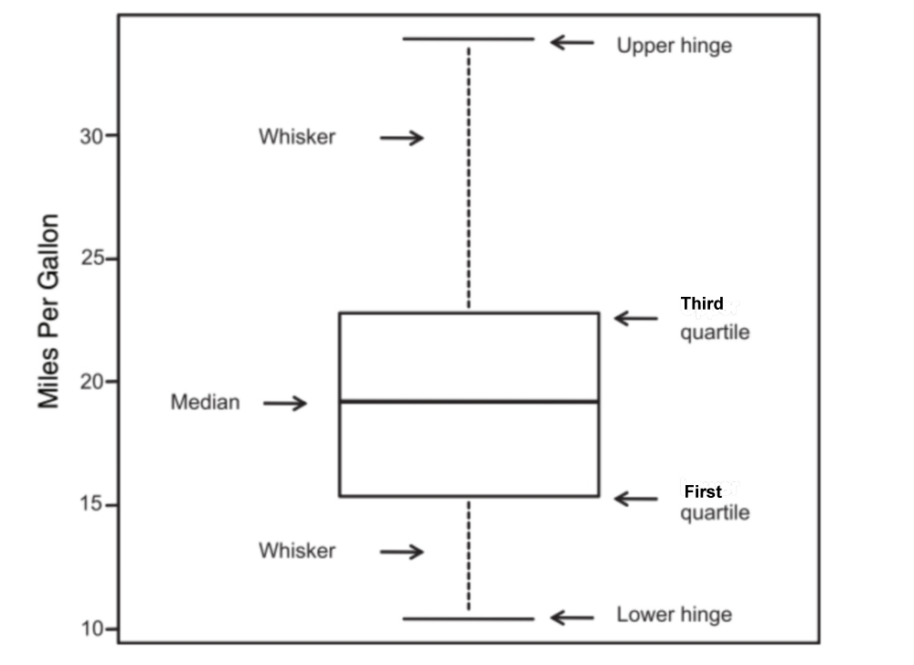
Five number summary

Slide 105
Five number summary
import scipy.stats # need to import the subpackages
sp.stats.describe(x) # displays summary statistics
DescribeResult(nobs=16, minmax=(1, 10), mean=4.5625, variance=5.1958, skewness=0.8408, kurtosis=0.3611)
Pandas has a describe method that gives us the five number summary
import pandas as pd y = pd.Series(x) y.describe()
count 16.000000 mean 4.562500 std 2.279437 min 1.000000 25% 3.000000 50% 4.000000 75% 5.250000 max 10.000000
Notes:
We compare scipy and pandas to do the same thing

Slide 106
Skewness
The scipy describe method gives us a somewhat different summary
sp.stats.describe(x)
DescribeResult(nobs=16, minmax=(1, 10), mean=4.5625, variance=5.1958, skewness=0.8408, kurtosis=0.3611)
Skewness is a measure of symmetry. A distribution, or data set, is symmetric if it looks the same to the left and right of the center point. Positive skewness indicates "skew right" and negative skewness indicates "skew left." A symmetric distribution has skewness = 0.
Kurtosis measures whether the data are heavy-tailed or light-tailed relative to a normal distribution. Positive kurtosis indicates a "heavy-tailed" distribution and negative kurtosis indicates a "light tailed" distribution. A normal distribution has kurtosis=0.

Slide 107
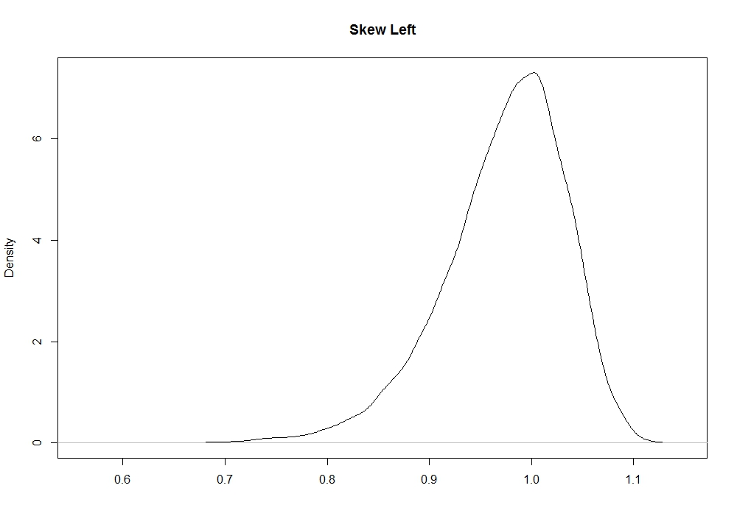
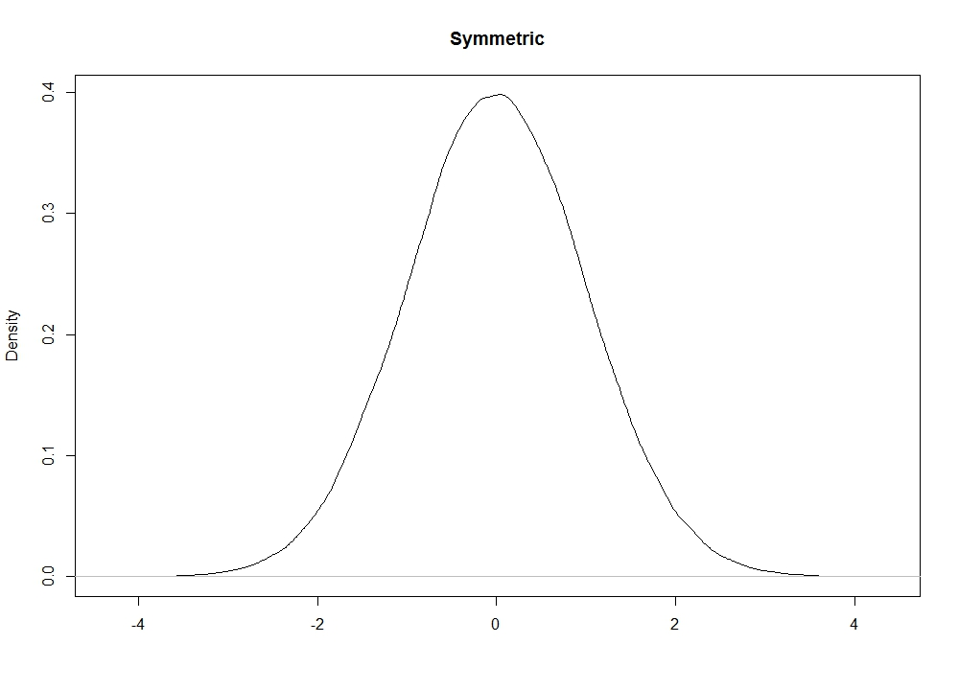
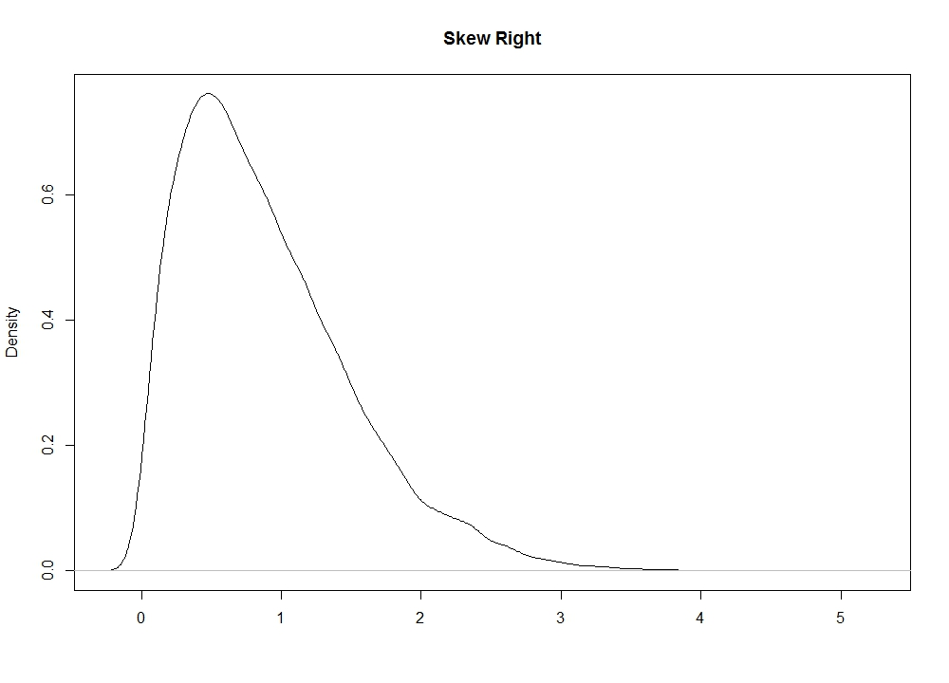
Skewness
Skew Left Symmetric Skew Right

Slide 108
Measures of Spread
Variance - the mean of the squares of the distance each data item is from the mean
Standard deviation - the square root of the variance
Range - the difference between the highest and lowest values in the data

Slide 109
Measures of Spread with Python
# variance calculations np.var(x) x.var() # standard deviation print('%.4f' % x.std()) print('%.4f' % np.std(x)) # you can even do this but why? np.sqrt(np.var(x)) # let's take another look calculating the standard deviation "by hand" y = (x-x.mean())**2 z = np.sqrt((y.sum()/len(x))) print('%.4f' % z)

Slide 110
Measures of Spread with Python
""" notice np.std() and np.var() divide by n by default which gives us the population standard deviation and variance; change the parameter ddof=1 to divide by n-1 for the sample standard deviation """ print('%.4f' % x.std(ddof=1)) print('%.4f' % np.std(x, ddof=1)) # check it with “hand” calculations w = np.sqrt((y.sum()/(len(x)-1))) print('%.4f' % w)

Slide 111
Homework
How to compute the average of the numbers in a string where each number (int or float) is separated by a comma? Write a function avgOysterSize to do so. Test your function extensively. Your function must be able to deal with the following cases (and much more):
“1,2,5.3,4”
“1, 2, 3, 4, 3.5, 6”
“ 1,2,5.0”
Etc.
Propose 4-5 data science questions you could explore on the BOP data (per person, NOT per team)

Slide 112
End of the 4th session

Slide 113
Data Science with Python
Session V
STEM INSTITUTE 2019

Slide 114
Outline
Did you do the homework?
Timeline of the project
Exploring the data
Arrays, DataFrame and Series
Getting started with the BOP data in Python
We will consider the following example:
Means of the oyster sizes for each substrate within one expedition

Slide 115
Timeline of the project
Listen carefully to the lecture and practice
Monday
Review of your research questions (homework)
Dealing with data in Python
Tuesday
Brainstorming and final review of the research question
Data visualization in Python
Work on the project
Wednesday
Work on the project - Morning and afternoon
Thursday
Working on the project - Morning
Friday
Presentations

Slide 116
Exploring the data
How would you get the answer to this question using the data? (no python)
We will consider the following example:
Means of the oyster sizes for each substrate within one expedition

Slide 117
Arrays
NumPy defines n-dimensional array objects (ndarray) which are fast, flexible containers for large data sets in Python
Arrays contain elements of the same type
Arrays allow operations between arrays and scalars
# lists are appropriate to create an array
import numpy as np data = [6, 5, 9, 8]
arr = np.array(data)
# operations on arrays
arr * arr
# operation with scalar
1/arr
arr ** 0.5
# 2-dimensional array
arr1 = np.array([data, data])

Slide 118
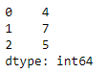
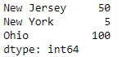
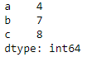
DataFrame and Series
Pandas provides two important data structures: DataFrame and Series
A Series is a one-dimensional object containing an array of data called values (of any Numpy data type) and an associated array of data labels called index
import pandas as pd
s = pd.Series([4, 7, 5]) # series from an array
# the indices are on the left and the values are on the right
s s.values #array([4, 7, 5])
s.index #RangeIndex(start=0, stop=3, step=1)
# series from a dictionary
dict ={'Ohio' : 100, 'New York' : 5, 'New Jersey' : 50}
s1 = p.Series(dict)
s1
# series from 2 arrays - values and index
s2 = p.Series([4,7,8], index=['a', 'b', 'c'])
s
s1
s2

Slide 119
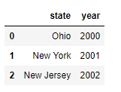
DataFrame and Series
A DataFrame is a spreadsheet-like data structure containing an ordered collection of columns (with different value types). It has a row and column index
import pandas as pd data = {'state' : ['Ohio', 'New York', 'New Jersey'], 'year': [2000, 2001, 2002]} df = pd.DataFrame(data) df.columns
df.values
df.index
df.head() # 5 first rows
df.tail() # 5 last rows
df.shape # number of rows and columns in this order
df.iloc[1] # row1
df.iloc[1]['state'] # specific element
df.index = ['row1', 'row2', 'row3'] # renaming the index
df.replace(['Ohio'], ['Iowa']) #replace a value
df.columns = [‘state’, ‘newyear’] # renaming the columns

Slide 120
Getting Started with the BOP Data
%matplotlib notebook import numpy as np import scipy as sp from scipy import stats import pandas as pd import matplotlib.pyplot as plt import seaborn as sns
sns.set()
# let Python know that the first row is the header. data2018 is a DataFrame data2018 = pd.read_csv('C:/your path and /filename.csv', header=0)
# look at the first five rows data2018.head() # and the last five rows data2018.tail()
What do you notice about the structure of the BOP data?
What do we need to change?
What is the path to the csv file?

Slide 121
Getting Started with the BOP Data
# We can transpose a pandas DataFrame data2018 = data2018.T data2018.head()
""" While that switched columns and rows the column labels are the original indices the column labels are not what we want. In fact the first row contains the variable names. """ data2018.columns = data2018.iloc[0] data2018.head()
# drop the first row
data2018 = data2018.drop(data2018.index[0])
# Display the column names data2018.columns

Slide 122
Getting Started with the BOP Data
# display the number of rows and columns (in that order) data2018.shape # print all the variable / column names for i in range(len(data2018.columns)): print(data2018.columns[i]) # print the Measurements for the first few expeditions for i in range(0, 3): print(data2018.iloc[i]["Measurements (mm)"]) # print the Measurements for all substrates for the second expedition data2018.iloc[1]["Measurements (mm)"]

Slide 123
Getting Started with the BOP Data
# We can select multiple columns, passing the names in a list # This displays the selected columns for all expeditions data2018[["Measurements (mm)", "Total number of all live oysters"]] Note:
# If I have two DataFrames, I can join them. axis=1 means merge the columns # The result is a DataFrame whose columns is the union of the two df = pd.concat([df1, df2], axis =1)

Slide 124
Digging Deeper into the Data Structure
""" Extract the values for each substrate shell for one expedition Recall the expeditions are the rows so we use .iloc to pass the index location (row number) This will create an array of strings, each string contains the measurements vals is of type numpy.ndarray, and each element of vals is a str """ vals = data2018.iloc[0]["Measurements (mm)"].values type(vals) # ndarray (array of strings) type(vals[0]) # str vals # display the array

Slide 125
Digging Deeper into the Data Structure
# we can't find the mean yet because this is an array of str - compare to the next cell vals[0].split(",")
# This throws an error because vals[1] is nan and nan's are floats not str
vals[1].split(",")
# Pandas Series and DataFrames can use the dropna() method
pd.Series(vals).dropna()
# And to_numeric() converts strings to floats
pd.to_numeric(pd.Series(vals[0].split(",")))

Slide 126
Digging Deeper into the Data Structure
for v in range(len(vals)): # let's walk through the string array
if type(vals[v]) == str: # if the type is str then we can split() and make it a float
print(pd.to_numeric(pd.Series(vals).dropna()[v].split(",")))
# we can also print the mean for each substrate
print('Substrate Shell #' + str(v+1) + ": \t The mean is ",
'%.3f' % pd.to_numeric(pd.Series(vals).dropna()[v].split(",")).mean(), sep='\t')
You will need to think about the type for each object with which you are working
As you can see because of the way the BOP data are recorded, you’ll need to do a lot of data mungling

Slide 127
End of the 5th session

Slide 128
Data Science with Python
Session VI
STEM INSTITUTE 2019

Slide 129
Data Visualization
With Python and BOP data

Slide 130
Data
The slides are based on https://github.com/fparisi/STEM-2019

Slide 131
Project: What do you need to deliver and present on?
Research question
Description of the data
Data science process
High-level algorithms / steps
Python code with comments
Answer to the research question
At least two graphs / charts
Exploration or results graphs / charts
Discussion on your experience with using real data

Slide 132
You are presenting your project
TODAY

Slide 133

Fun
M.C. Escher, Sky and Water, 1938

Slide 134

Fun
M.C. Escher, Waterfall, 1961

Slide 135

Fun
Josef Muller-Brockmann, Strawinsky, Fortner, Berg, 1955
Notes:
http://graphicdesign-article.blogspot.com/2007/08/international-typographic-style.html
https://www.linkedin.com/pulse/josef-m%C3%BCller-bockmann-swiss-modernist-branding-master-tony-wessling

Slide 136
Data Visualization
Graphs are one way to visualize data
The purpose of graphs is to show relationships and convey information
Poorly designed graphs can mislead
Some graphs we’ll look at:
Histograms: Display the distribution of a continuous variable by dividing the range a number of bins on the x-axis and displaying the frequency in each bin on the y-axis
Bar charts: Display discrete data and are good at showing comparisons
Box and Whiskers Plots: Display the distribution of a continuous variable highlighting the quartiles, the extreme points, and any outliers
Scatter Plots and Line Plots: Are useful for displaying the relationship between variables; line plots also show time series data

Slide 137
Preparing Data for Analysis
# The following code extracts the Water Color and Measurements data into another DataFrame
# Not necessary but it’ll make this example clearer without excess data
# Extract measurements and water color only
df = data2018[["Measurements (mm)","Water color\r\n(1=Light Blue,2=Dark Blue,3=Light Green,\r\n4=Dark Green,5=Light Brown,6=Dark Brown)"]]
row, col = df.shape # get the dimensions of the dataframe
wc = pd.Series(df.iloc[:,col-1]).astype(float) # Extract water colors and convert to float
y = pd.Series() # empty series

Slide 138
Preparing Data for Analysis
for r in range(row):
x = pd.Series()
for c in range(col-1):
if type(df.iloc[r,c]) == str:
h = pd.Series(df.iloc[r,c].split(",")).astype(float)
for i in range(len(h)):
if h.iloc[i] == 99999.0: # some use 99999 as missing value
h = np.nan
x = x.append(pd.Series(h))
else:
x = x.append(pd.Series(df.iloc[r,c]).astype(float))
y = y.append(pd.Series(x.mean()))
WC = pd.DataFrame({'Water Color': wc.values, 'Mean': y})
WC.groupby('Water Color').mean()

Slide 139
Working with All the Measurements Data
# This stacks the measurements based on water color
v1 = np.array([])
v2 = np.array([])
v3 = np.array([])
v4 = np.array([])
v5 = np.array([])
v6 = np.array([])

Slide 140
Working with the Measurements Data
for l in range(len(data2018["Measurements (mm)"].values)):
# temp stores the observations for one expedition
for t in range(10):
if pd.notnull(data2018.iloc[l]['Measurements (mm)'].values[t]):
w = np.array(data2018.iloc[l]["Measurements (mm)"].values[t].split(",")).astype(float)
if data2018.iloc[l][wc] == '1':
v1 = np.append(v1, w)
elif data2018.iloc[l][wc] == '2':
v2 = np.append(v2, w)
elif data2018.iloc[l][wc] == '3':
v3 = np.append(v3, w)
elif data2018.iloc[l][wc] == '4':
v4 = np.append(v4, w)
elif data2018.iloc[l][wc] == '5':
v5 = np.append(v5, w)
else:
v6 = np.append(v6, w)
else:
next

Slide 141
Preparing Data for Analysis
# Combine the measurements with water color into a new data frame measures = np.concatenate((v1, v3, v4, v5, v6), axis=0) measures = pd.DataFrame({'Measures': measures}) measures['WaterColor'] = np.zeros(len(measures['Measures'])) ind = np.array([len(v1), len(v2), len(v3), len(v4),len(v5),len(v6)])
cumind = np.cumsum(ind)
for i in range(cumind[0]): measures.loc[i, 'WaterColor'] = 1
for j in range(5): for i in range(cumind[j],cumind[j+1]): measures.loc[i, 'WaterColor'] = j+2
measures = measures[measures['Measures']!= 99999] # some of entries are 99999 for missing

Slide 142
Histograms
measures.head() Measures WaterColor
0 105.0 1.0
1 88.0 1.0
2 115.0 1.0
3 70.0 2.0
4 60.0 2.0
# make a histogram measures['Measures'].plot.hist()
Notes:
https://docs.scipy.org/doc/numpy/reference/generated/numpy.histogram.html

Slide 143
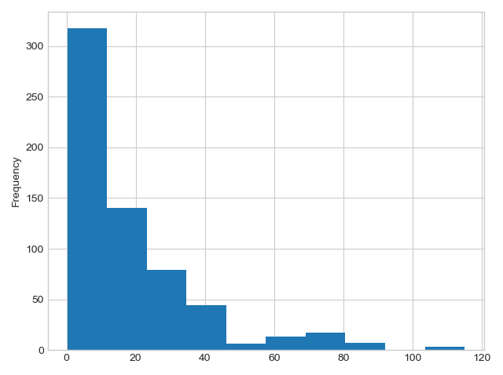
Histograms
Histogram displays the distribution of the data

Slide 144
Bar Charts
measures.groupby('WaterColor').mean()
WaterColor Measures
1.0 102.666667
2.0 71.500000
3.0 13.686275
4.0 15.664921
5.0 14.943979
6.0 32.142857
# Bar plot showing the mean by group measures.groupby('WaterColor').mean().plot.bar() # Bar plot showing the number by group measures.groupby('WaterColor').size().plot.bar()

Slide 145
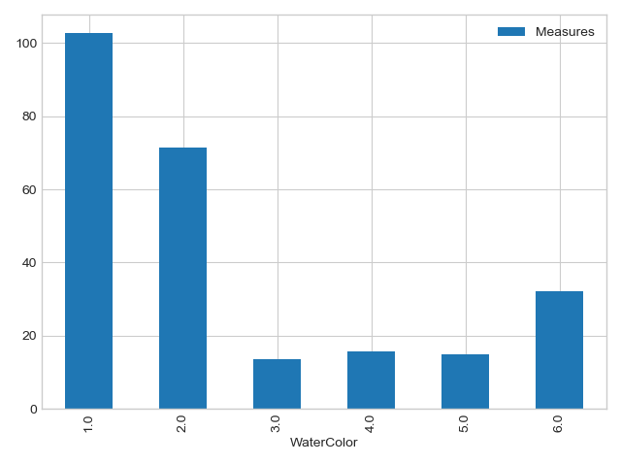
Bar Charts
Bar Plot Showing the Mean by Group

Slide 146
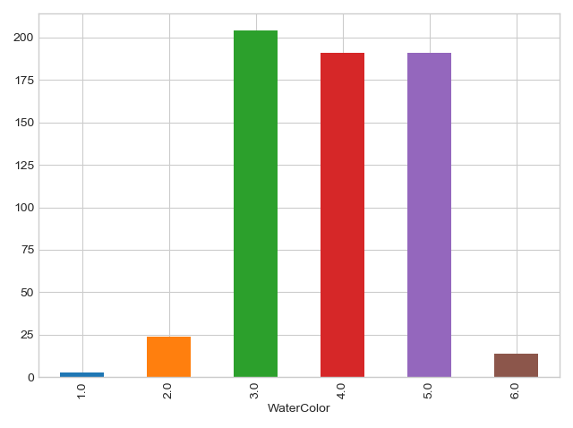
Bar Charts
Bar chart showing Count by Group

Slide 147
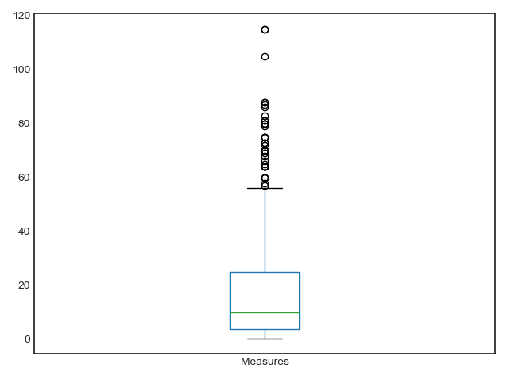
Box and Whisker Plots
Box plots display the distribution and provide more information than a histogram
measures['Measures'].plot.box()

Slide 148
Scatter Plots and Line Plots
“””
In this example, I made up a second variable to plot against my measurements data
I added random normal fluctuations to the measurements data
“””
measures['Measures + Noise'] = measures['Measures'] + np.random.normal(0,4,627)
# Scatter plot measures.plot.scatter(y = 'Noise', x = 'Measures') # Line plot measures['Measures'].plot()

Slide 149
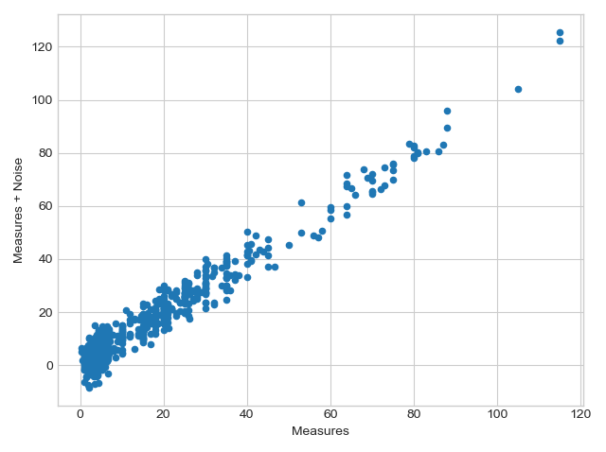
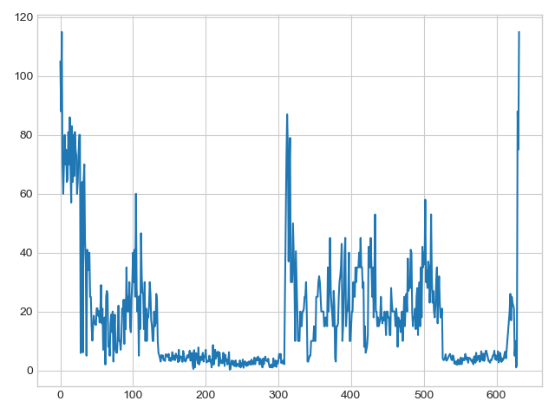
Scatter Plots and Line Plots
Scatter plots and line plots are useful for displaying the relationship between variables
Line plots are also used to display time series data

Slide 150
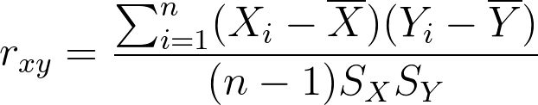
Correlation between two variables
Measures the degree of association between two variables
Ranges from -1 to +1, where -1 indicates perfect negative correlation and +1 indicates perfect positive correlation
We write the sample correlation between x and y as
where X is the sample mean for X, Y is the sample mean for Y, SX and SY are the sample standard deviation for X and Y respectively, and n is the sample size

Slide 151
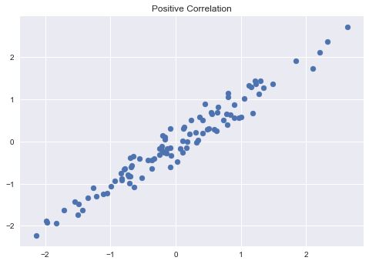
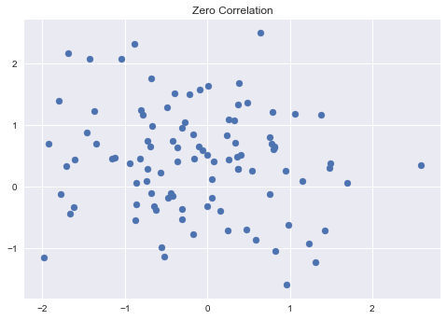
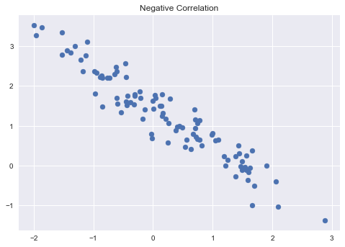
Correlation

Slide 152
Correlation
# we can calculate the correlation in several ways as well # np.corrcoef returns an np array np.corrcoef(measures['Measures'], measures['Noise']) array([[1. , 0.97899184],
[0.97899184, 1. ]])
# calculate Pearson's rho and the p-value # the p-value suggests the correlation is statistically significant rho, pstat = scipy.stats.pearsonr(measures['Measures'], measures['Measure + Noise']) print('rho = %.4f' % rho, 'p-val = %.4f' % pstat) rho = 0.9790 p-val = 0.0000

Slide 153
Hypothesis Testing
Hypothesis testing is used to test assumptions and theories and guide our decisions
State the level of significance α, the probability that you incorrectly reject the hypothesis H0
The levels of significance correspond to various quantiles of the standard normal distribution . . .
α = 0:05; Z = 1:96
α = 0:10; Z = 1:645
Refer to a Z table that provides the area under the curve for the cumulative normal distribution

Slide 154
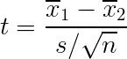
Hypothesis Testing - Two Independent Samples
Steps in hypothesis testing: Step 1: State the null and alternative hypotheses, H0, and Ha (or H1), determine if this is a one-sided or two-sided test Step 2: State α, the level of significance Step 3: Calculate the test statistic from the sample mean and standard error
Step 4: Compare the calculated test statistic to the critical value Step 5: Accept H0 if Z is in the acceptance region, or reject H0 if Z is in the critical or rejection region

Slide 155
Hypothesis Testing - Two Independent Samples
H₀ there is no statistically significant difference in the means (i.e., the means are the same)
H_{a} there is statistically significant difference in the means (i.e., the means are different)
# compare sample means tstat, pval = scipy.stats.ttest_ind(measures['Measures'], measures['Measures + Noise']) print('t-stat = %.3f ' % tstat, 'p-value = %.3f' % pval) t-stat = -0.133 p-value = 0.894

Slide 156

End of the STEM Summer Institute

